Slide 1
Turing Machine

Slide 2
Turing Machine
Turing Machine consists of a finite control, and a tape.
The finite control can be in any of a finite set of states
The tape is divided into cells which hold any one of a finite number of symbols

Slide 3
Turing Machine ( TM )
A move of Turing Machine will:
Change state
Write a tape symbol in the cell scanned
Move the tape head left/right

Slide 4
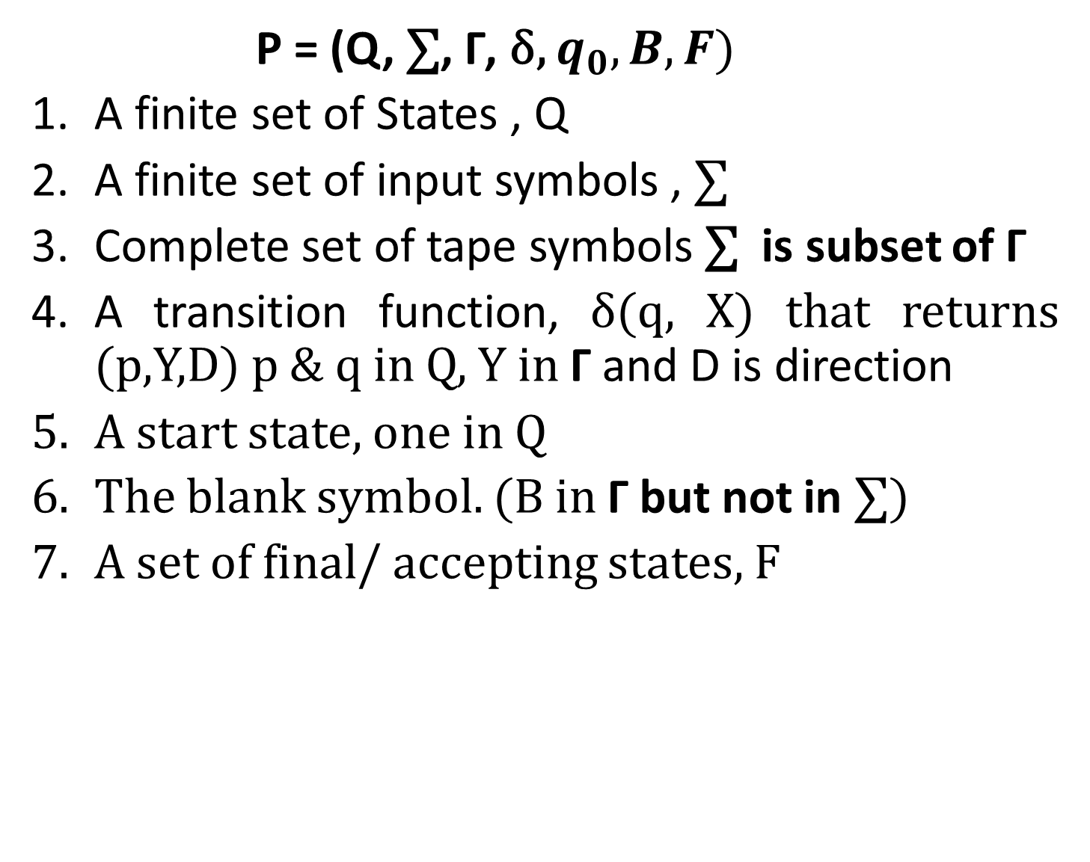
Formal Description of TM
P = (Q, $\text{∑}$, Γ, δ, $q_{0},B,F)$
A finite set of States , Q
A finite set of input symbols , $\text{∑}$
Complete set of tape symbols $\text{∑}$ is subset of Γ
A transition function, δ(q, X) that returns (p,Y,D) p & q in Q, Y in Γ and D is direction
A start state, one in Q
The blank symbol. (B in Γ but not in $\text{∑}$)
A set of final/ accepting states, F

Slide 5

Example
Design a Turing Machine to accept language of all strings over a and b of the form${ a}^{n}b^{n}$

Slide 6
Example
Design a Turing Machine to accept language of all strings over 0 and 1 which is a palindrome

Slide 7

Example
Design a Turing Machine to compute monus operation $m$n = max ( m - n , 0)

Slide 8



Linear Bounded Automata
P = (Q, $\text{∑}$, Γ, δ, $q_{0},ML,MR,F)$
A finite set of States , Q
A finite set of input symbols , $\text{∑}$
Complete set of tape symbols $\text{∑}$ is subset of Γ
A transition function, δ
A start state, one in Q
ML is the Left Marker
MR is the right Marker

